Slide 1
SOCIAL MEDIA FOR MARKETING
Social media marketing involves using platforms like Facebook, Instagram, X (formerly Twitter), and LinkedIn to promote brands and engage with customers
Why Is Social Media Marketing (SMM) So Powerful?
The power of SMM is driven by the unparalleled capacity of social media in three core marketing areas: connection, interaction, and customer data.

Slide 2
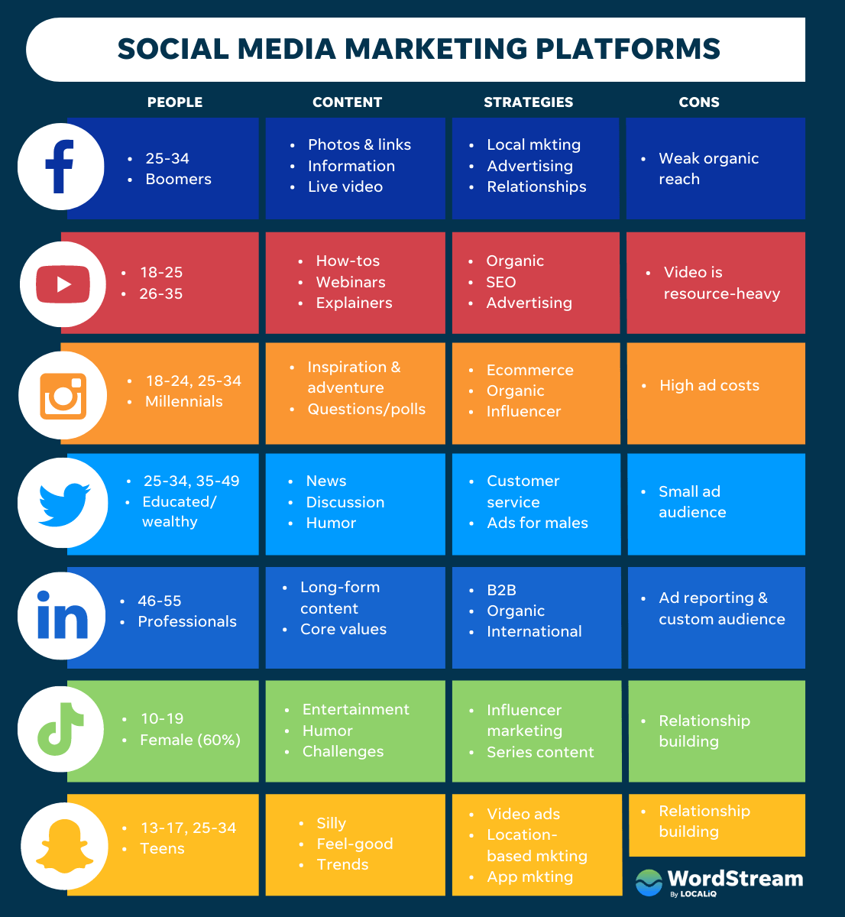

Slide 3
Customer Relationship Management (CRM)
Compared to traditional marketing, social media marketing has several distinct advantages, including the fact that SMM has two kinds of interaction that enable targeted customer relationship management (CRM) tools: both customer-to-customer and firm-to-customer. In other words, while traditional marketing tracks customer value primarily by capturing purchase activity, SMM can track customer value directly (through purchases) and indirectly (through product referrals).

Slide 4
The Power Of Social Media In
Modern Marketing
Social media has revolutionized the way businesses connect with their target audience. It has become an indispensable tool for marketers seeking to build brand awareness, engage with customers and drive sales. In this digital age, ignoring social media can be tantamount to neglecting a significant portion of your potential market, which we did for a while at my company.
In my own company's case, we initially hesitated to deploy more resources into our social media marketing because we were a bootstrapped, resource-constrained small business. We hesitated because we were not sure if these efforts would make a dent in our bottom line or not. So, for a while, social media was a side project for one of our editors. When we started seeing the returns, we realized it was time to hire a dedicated social media person.

